Slide 1

Customer & Banking Transactions Analysis
Business Analyst Project Using SQL
-By Lakshya Doomra

Slide 2
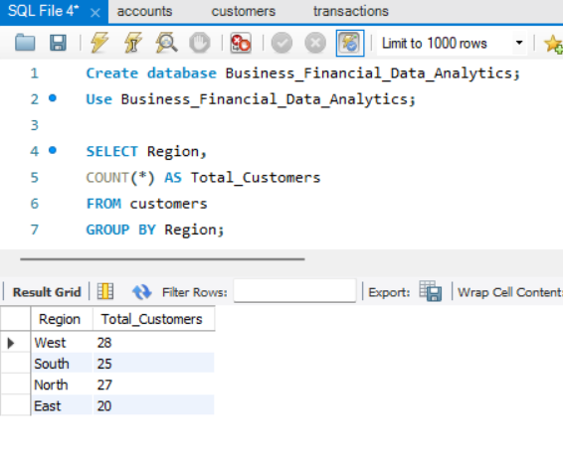
1. Customers per region
SQL QUERY
(Input)
OUTPUT
2. Since customer spread is fairly balanced, the bank is not overly dependent on one region — reducing regional risk.
1. The East region should be targeted with marketing campaigns, local offers, or new branch/digital service rollouts to close the gap.
📈 Insights:

Slide 3
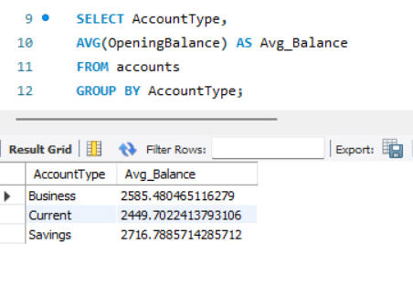
2. Average account balance by type
SQL QUERY
(Input)
OUTPUT
📈 Insights:
-> Here, Savings holders maintain slightly higher balances than business/current accounts.
-> Again, not much difference, Current account customers may need working capital or overdraft products since balances are little lower.

Slide 4
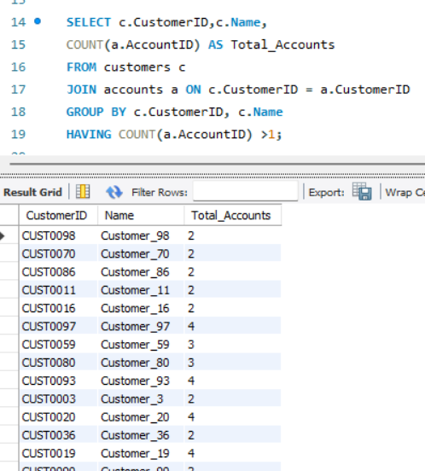
3. Multi-account customers
SQL QUERY
(Input)
OUTPUT
📈 Insights:
Here. 40+ customers have multiple accounts (up to 6 accounts each).
Many customers trust the bank enough to open multiple accounts.
Customers with 4–6 accounts (e.g., CUST0033, CUST0048) are strong candidates for priority banking.
Offer loyalty programs for customers with ≥3 accounts.
Monitor high-activity customers for cross-selling loans or investment products.

Slide 5
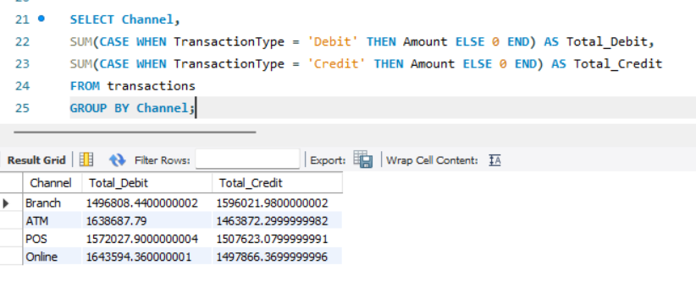
4. Debit vs. Credit volume by channel
SQL QUERY
(Input)
OUTPUT
📈 Insights:
Online & ATM Dominate (1.6M each) → Digital transactions are more active than branch/POS.
Traditional banking remains relevant and usage is still strong (1.5–1.6M)
We can Push digital banking campaigns to reduce branch load.

Slide 6
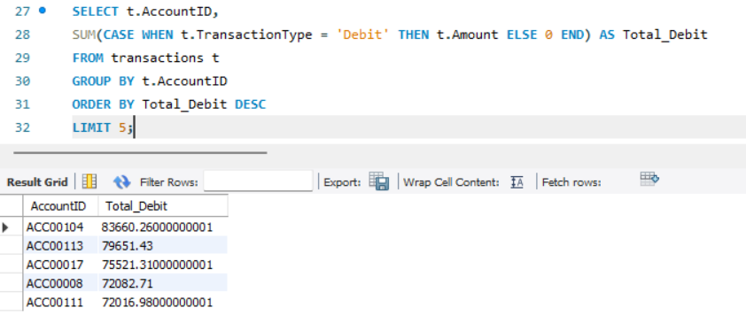
5. Top debit accounts
SQL QUERY
(Input)
OUTPUT
📈 Insights:
Top 5 accounts contribute very high debit volume (₹380K total).
These accounts are likely business or high-income clients.
We can Assign relationship managers to these accounts

Slide 7
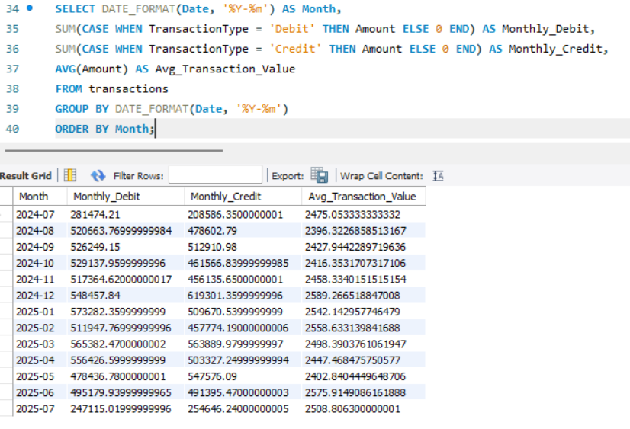
6. Monthly transaction trends
SQL QUERY
(Input)
OUTPUT
📈 Insights:
Seasonal Peaks (Dec–Jan) → Likely due to festive season spending & year-end bonuses.
Plan campaigns during festive months (Nov–Jan) → maximize revenue
Investigate July 2025 slowdown → push targeted offers to boost activity.

Slide 8
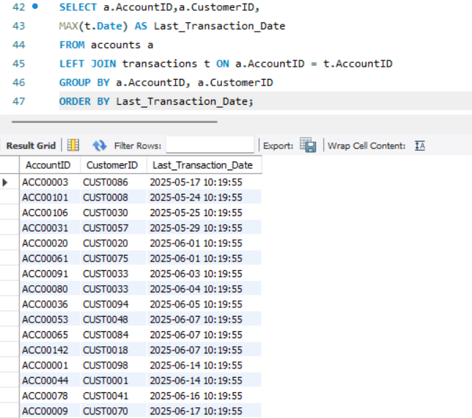
7. Last Transaction Date per Account
SQL QUERY
(Input)
OUTPUT
📈 Insights:
High Activity in June–July 2025 : Customers are active; recent transactions confirm strong engagement.
Multi-account customers (CUST0099, CUST0048) show regular activity across accounts, suggesting high-value profiles.
Flag accounts with >60 days inactivity for re-engagement campaigns
Prioritize multi-account active users for loyalty offers.

Slide 9
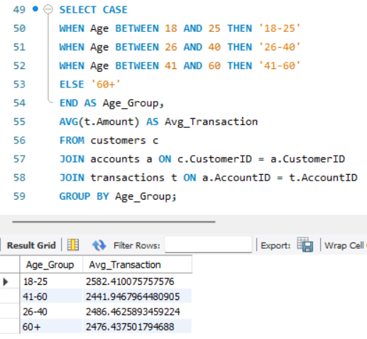
8. Average transaction amount by age group
SQL QUERY
(Input)
OUTPUT
📈 Insights:
Youngest group (18–25) spends the most (₹2582):
Indicates higher adoption of digital/payment channels.
Target 18–25 group with youth-oriented financial products (UPI, credit cards, micro-investments).
41–60 group spends least (~₹2442): Possibly more cautious or diversified spending habits.
Retain 41–60 group with wealth products (mutual funds, insurance, retirement).

Slide 10
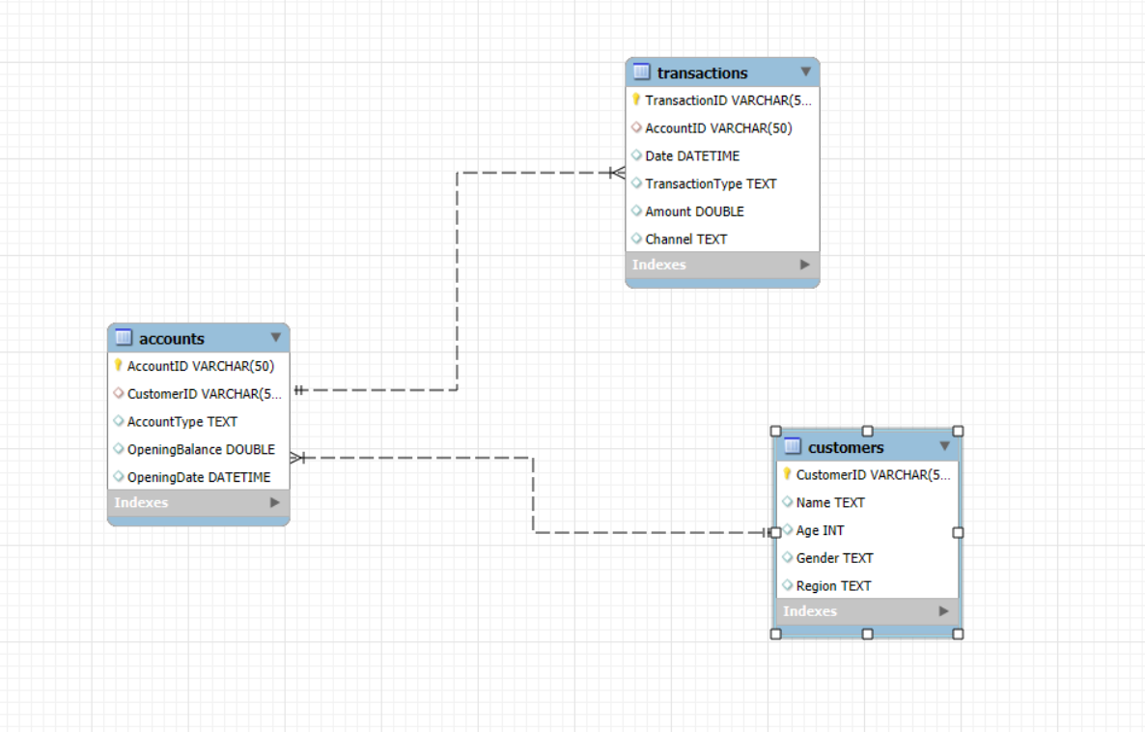
ER DIAGRAM:
This ER diagram represents the relational structure of the database, highlighting three tables – customers, accounts and transactions. It shows how customers can have multiple accounts, and each account can record multiple transactions. This design ensures data integrity and allows efficient analysis of customer behavior, account balances, and transaction patterns

